Slide 1
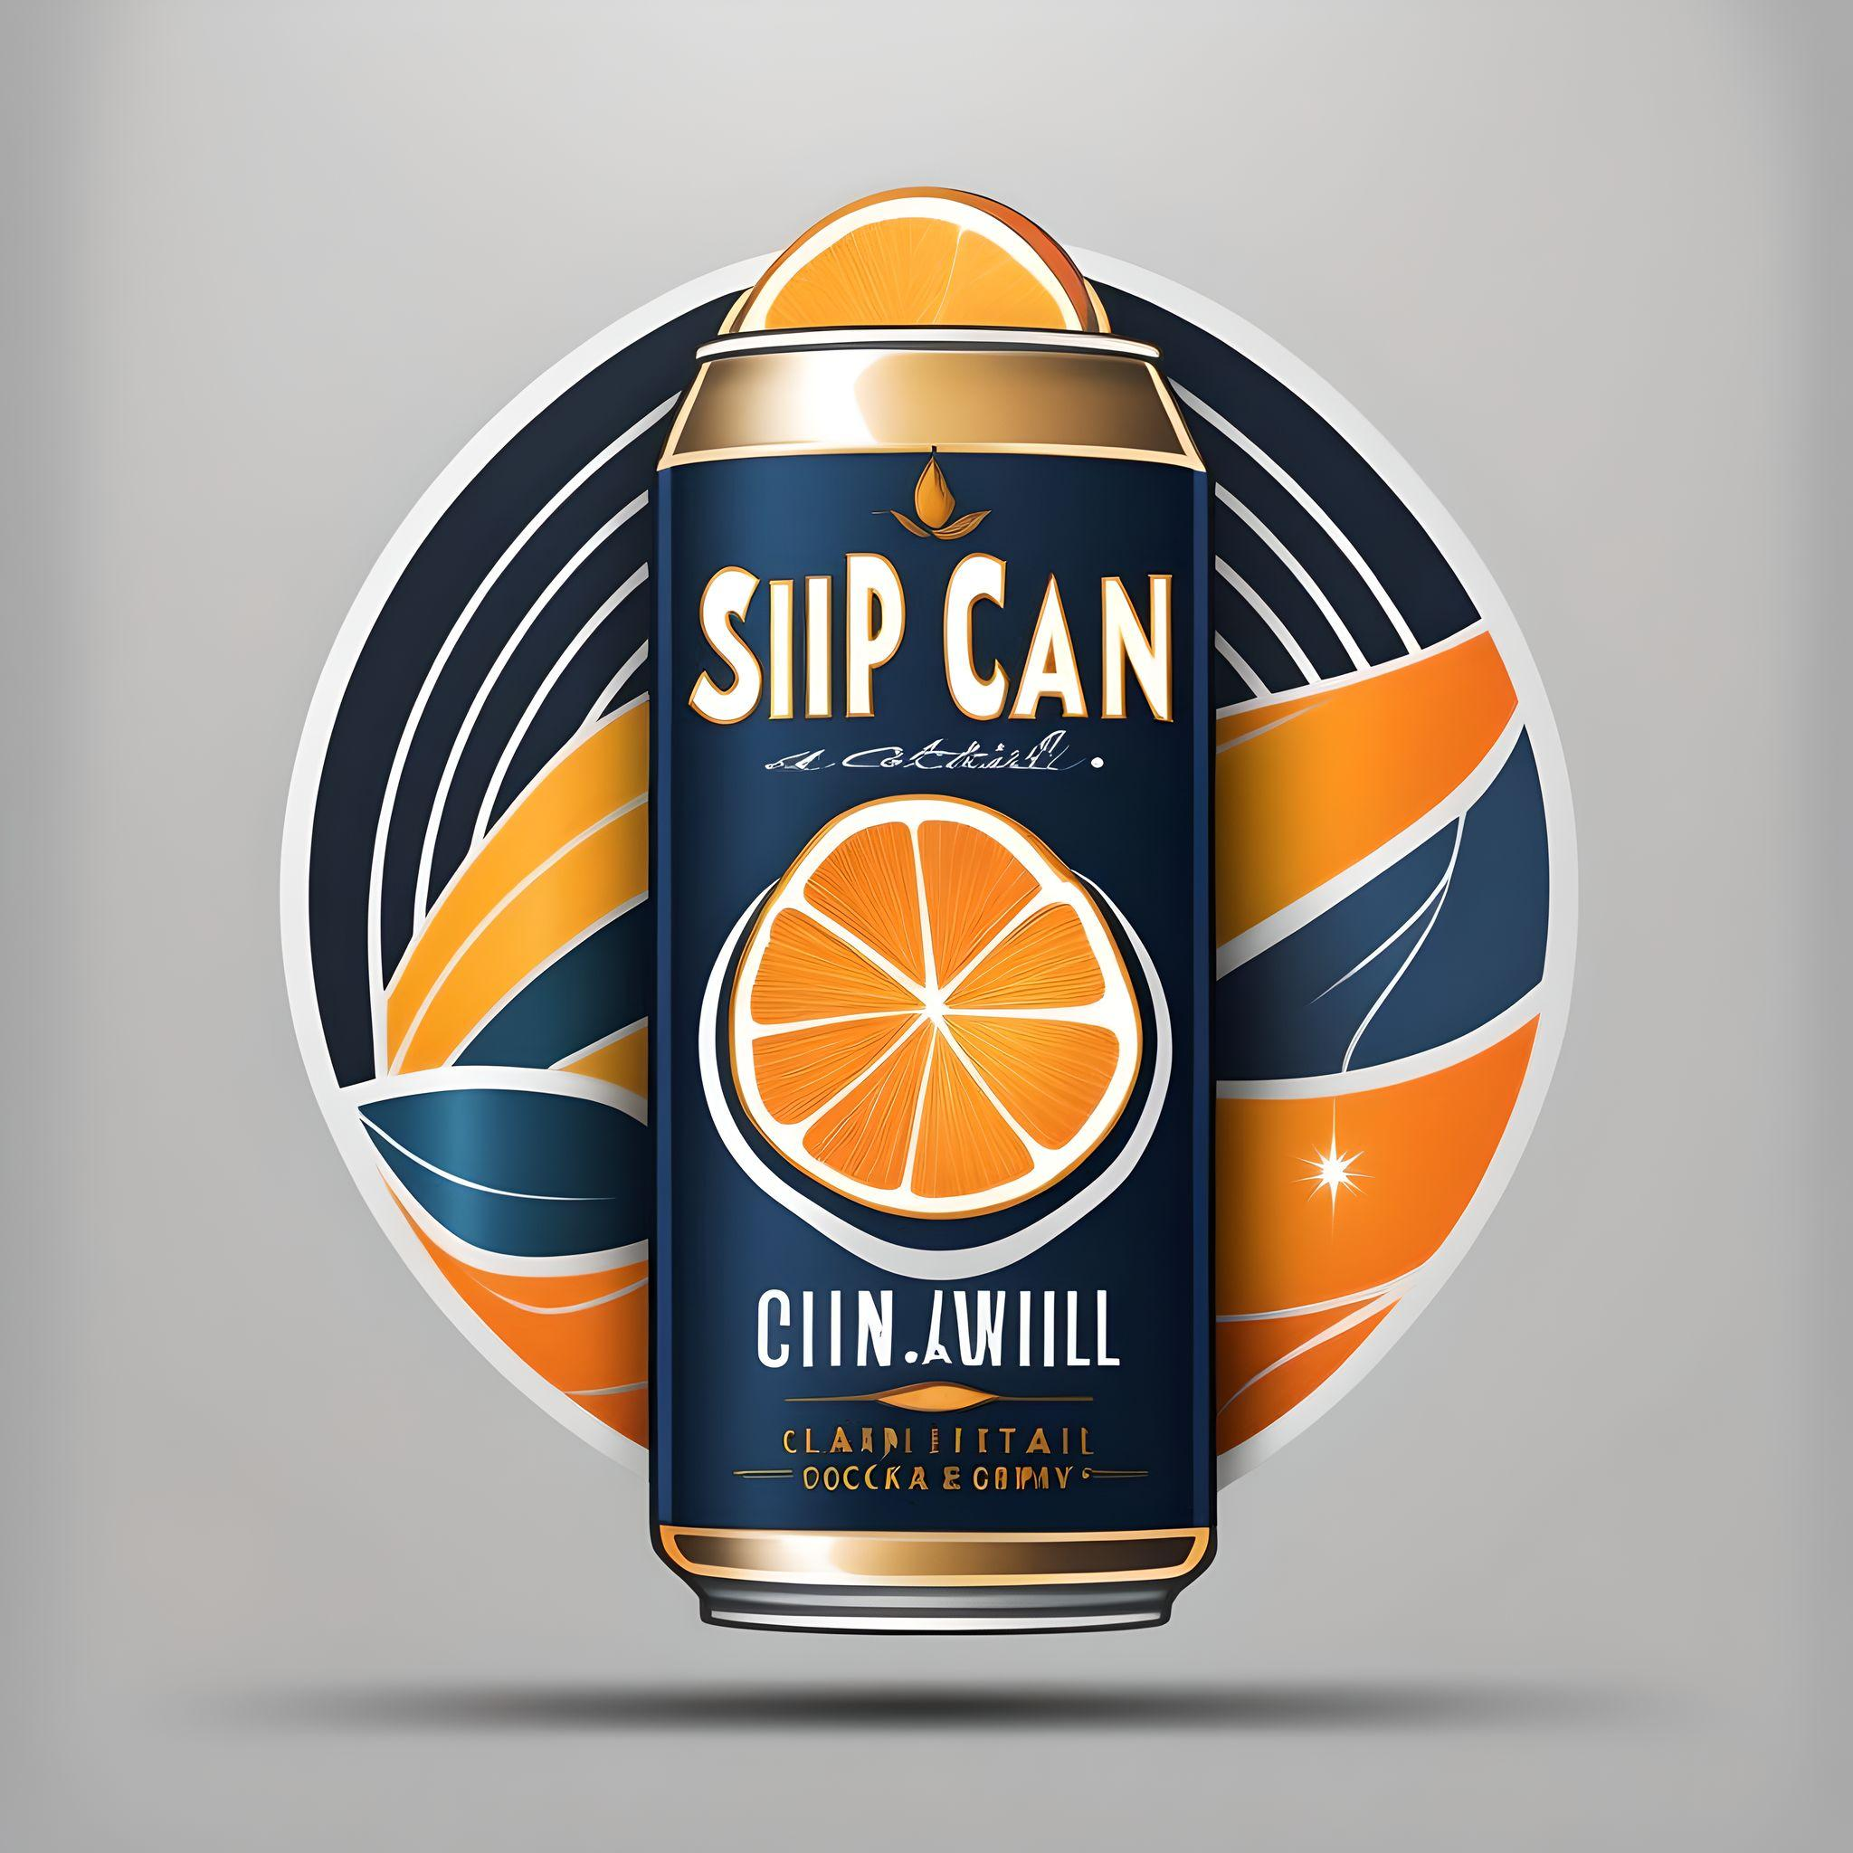
Sip-n-Can
CRAFTED CANNED DRINKS
Our cocktails combine high-quality ingredients with innovative flavors, making them stand out in the market
Just GRAB , POP & ENJOY !!
Its that simple !!

Slide 2
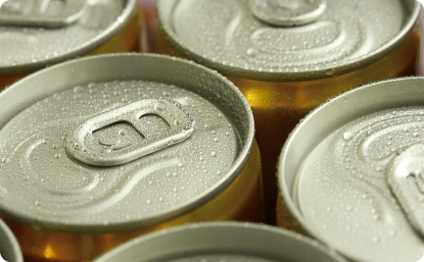

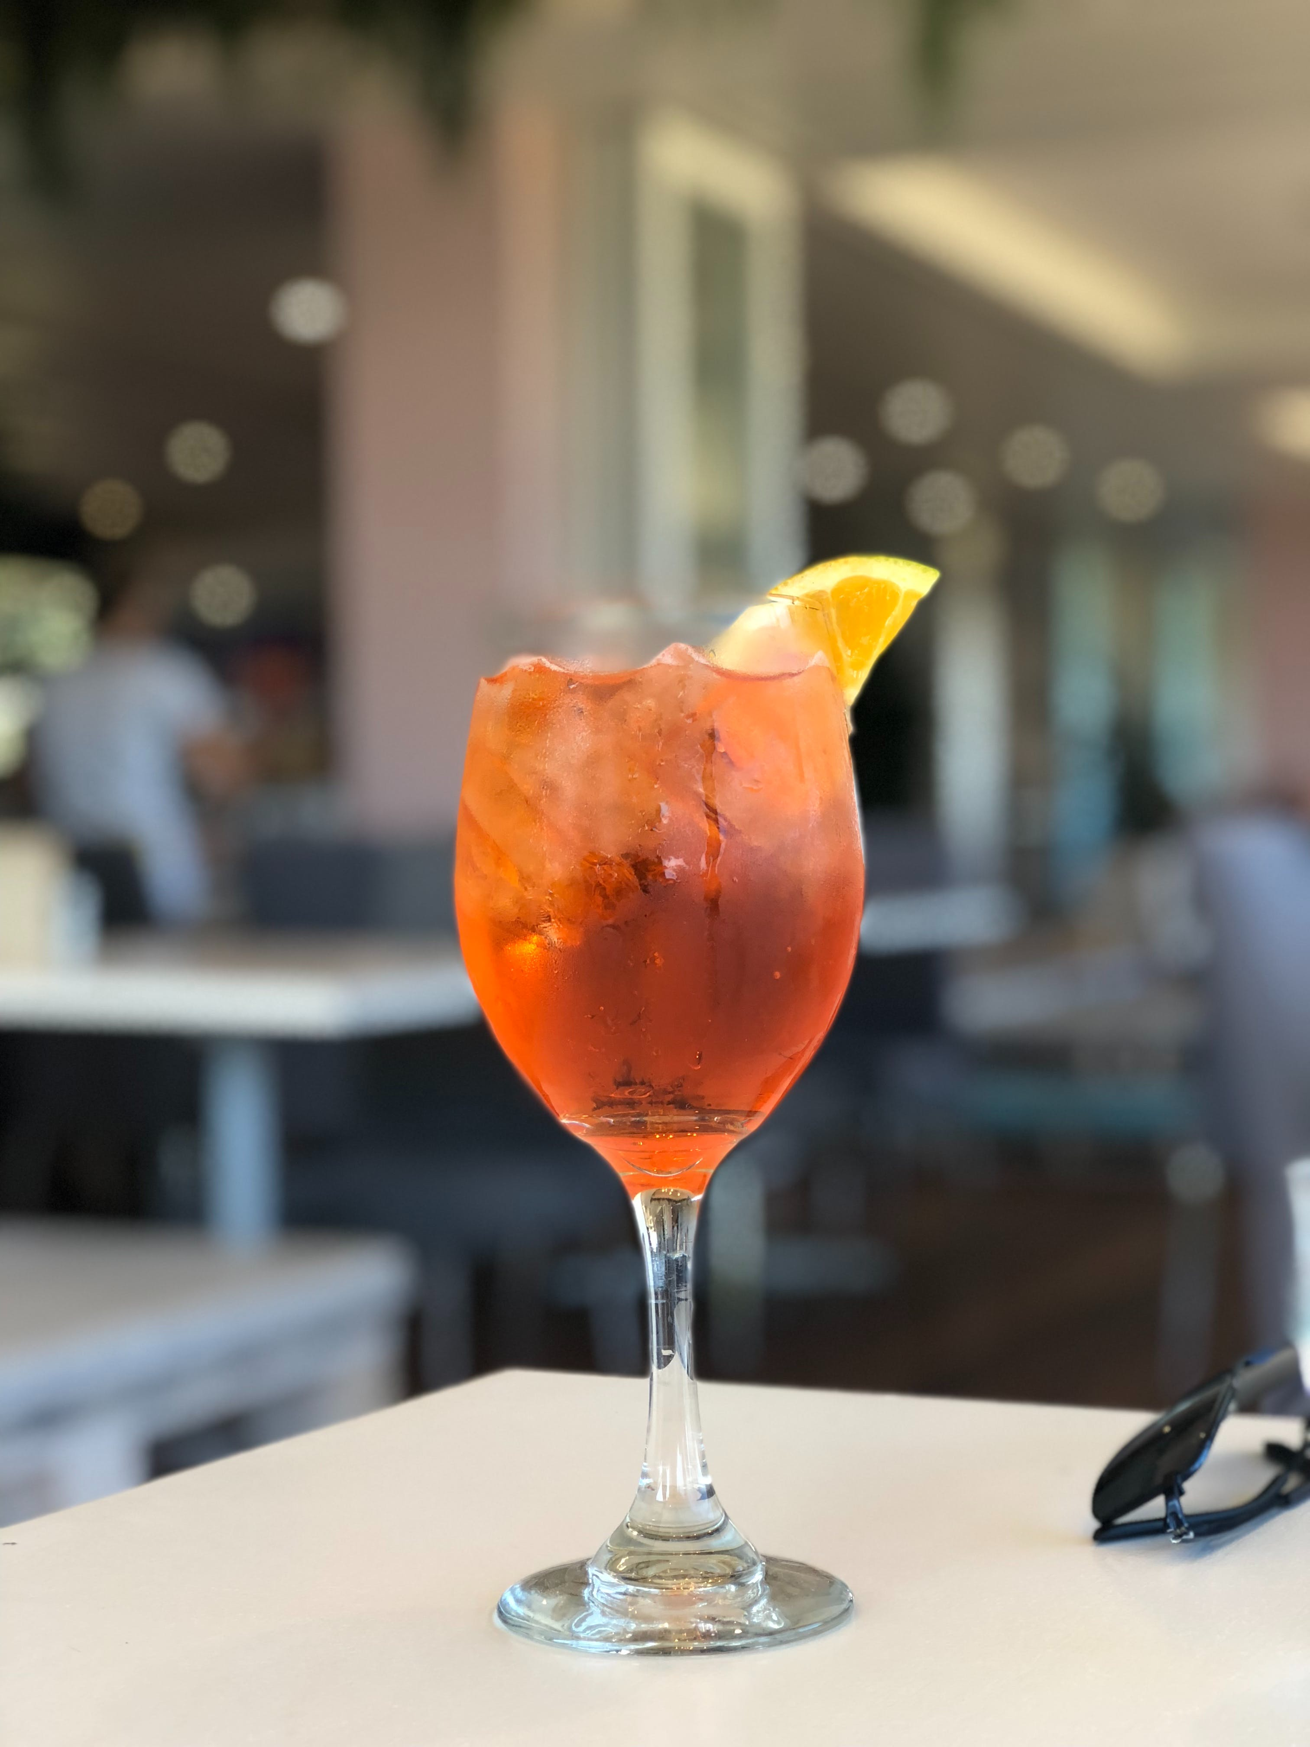
RIN-N-TONIC JISKEY WHISKEY NO GUM RUM ESPRESSO MARTINI RIN-N-TONIC JISKEY WHISKEY NO GUM RUM ESPRESSO MARTINI RIN-N-TONIC JISKEY NO G
Our Journey So Far
Founding Journey
Our company was born out of a passion for mixology and a desire to create exceptional cocktails that capture the essence of India's rich and diverse flavors.
Milestones Achieved
From humble beginnings to establishing a strong presence, we have overcome challenges and celebrated significant milestones in our pursuit of excellence.
RIN-N-TONIC JISKEY WHISKEY NO GUM RUM ESPRESSO MARTINI RIN-N-TONIC JISKEY WHISKEY NO GUM RUM ESPRESSO MARTINI RIN-N-TONIC JISKEY NO G

Slide 3
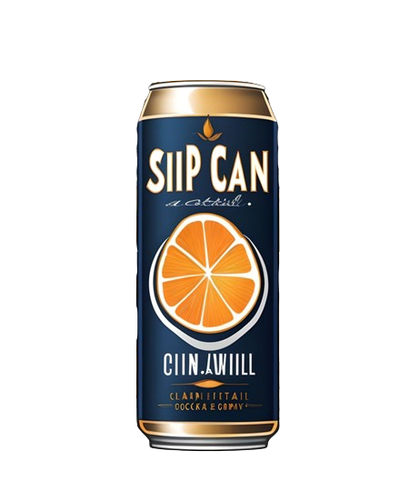
MRIN-N-TONIC JISKEY WHISKEY NO GUM RUM ES MARTINI RIN-N-TONIC JISKEY WHISKEY NO GUM RUM ESPRESSO MARTINI RIN-N-TONIC JISKEY NO GUM RU
Market Analysis: The Demand for Canned Cocktails in India
Rising Trend
Consumer Insights
Competitive Landscape
With the evolving lifestyle and the growing preference for convenient yet high-quality beverages, the demand for canned cocktails in India is on a significant rise.
Market research indicates a strong inclination towards premium canned cocktails, presenting a lucrative opportunity in India's evolving beverage landscape.
Despite the existing options, there is an unmet need for uniquely crafted cocktails, positioning us to fill a gap in the market with our distinctive offerings.
RIN-N-TONIC JISKEY WHISKEY NO GUM RUM ESPRESSO MARTINI RIN-N-TONIC JISKEY WHISKEY NO GUM RUM ESPRESSO MARTINI RIN-N-TONIC JISKEY NO G

Slide 4


RIN-N-TONIC JISKEY WHISKEY NO GUM RUM ESPRESSO MARTINI RIN-N-TONIC JISKEY WHISKEY NO GUM RUM ESPRESSO MARTINI RIN-N-TONIC JISKEY NO G
Our Product Range
1
Authentic Flavors
2
Premium Quality
From classic concoctions to innovative blends, our range of canned cocktails showcases the diverse and authentic flavors of India.
We meticulously source the finest ingredients to ensure each sip of our cocktails embodies quality, freshness, and the essence of Indian craftsmanship.
3
Convenience Redefined
Our ready-to-drink cocktails offer the perfect balance of convenience and sophistication, allowing our consumers to savor delightful moments anytime, anywhere.
RIN-N-TONIC JISKEY WHISKEY NO GUM RUM ESPRESSO MARTINI RIN-N-TONIC JISKEY WHISKEY NO GUM RUM ESPRESSO MARTINI RIN-N-TONIC JISKEY NO GU

Slide 5
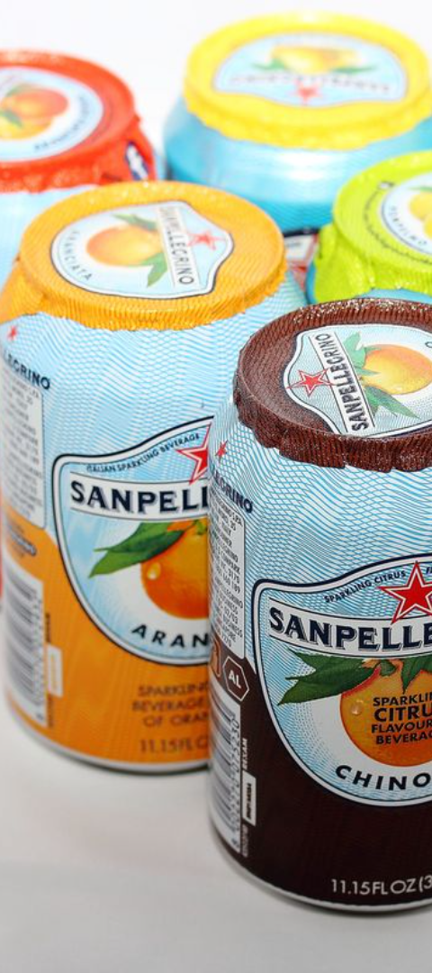
RIN-N-TONIC JISKEY WHISKEY NO GUM RUM ESPRESSO MARTINI RIN-N-TONIC JISKEY WHISKEY NO GUM RUM ESPRESSO MARTINI RIN-N-TONIC JISKEY NO GU
Our Vision: Catalyst for Change
1
Motivation Behind the Company
We embarked on this journey with a vision to redefine the cocktail experience, infusing tradition with innovation to create unparalleled beverages for the Indian market.
2
Sustainable Impact
Driven by our commitment to sustainability, we aim to minimize our environmental footprint while maximizing the enjoyment of our responsibly crafted cocktails.
3
Empowering Community
Our vision extends beyond offering great drinks. We aspire to contribute to the local community by creating opportunities and fostering a culture of inclusivity and creativity.
RIN-N-TONIC JISKEY WHISKEY NO GUM RUM ESPRESSO MARTINI RIN-N-TONIC JISKEY WHISKEY NO GUM RUM ESPRESSO MARTINI RIN-N-TONIC JISKEY NO GU

Slide 6
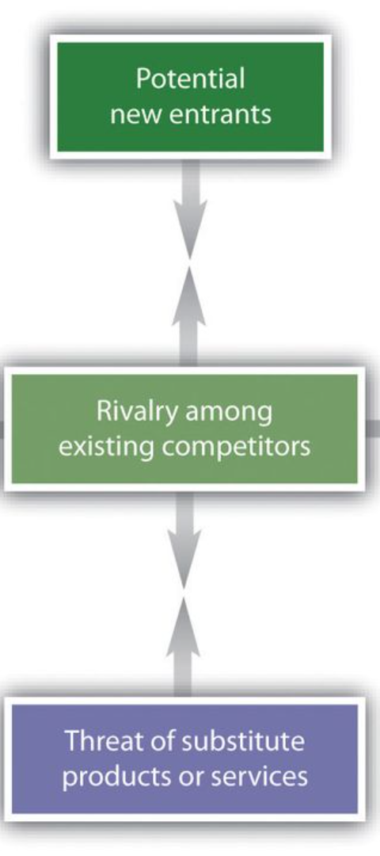



Competitive Advantage: Setting Ourselves Apart
Cultural Fusion
We bring an authentic Indian twist to traditional and contemporary cocktail recipes, offering a delightful fusion of flavors that is unparalleled in the market.
Sustainable Practices
Our commitment to sustainability and environmentally ethical practices sets us apart, resonating with conscious consumers and emphasizing our responsible ethos.
Innovative Packaging
Our eco-friendly, visually appealing cans not only preserve the taste and quality of our cocktails but also reflect our dedication to aesthetic and environmental consciousness.

Slide 7
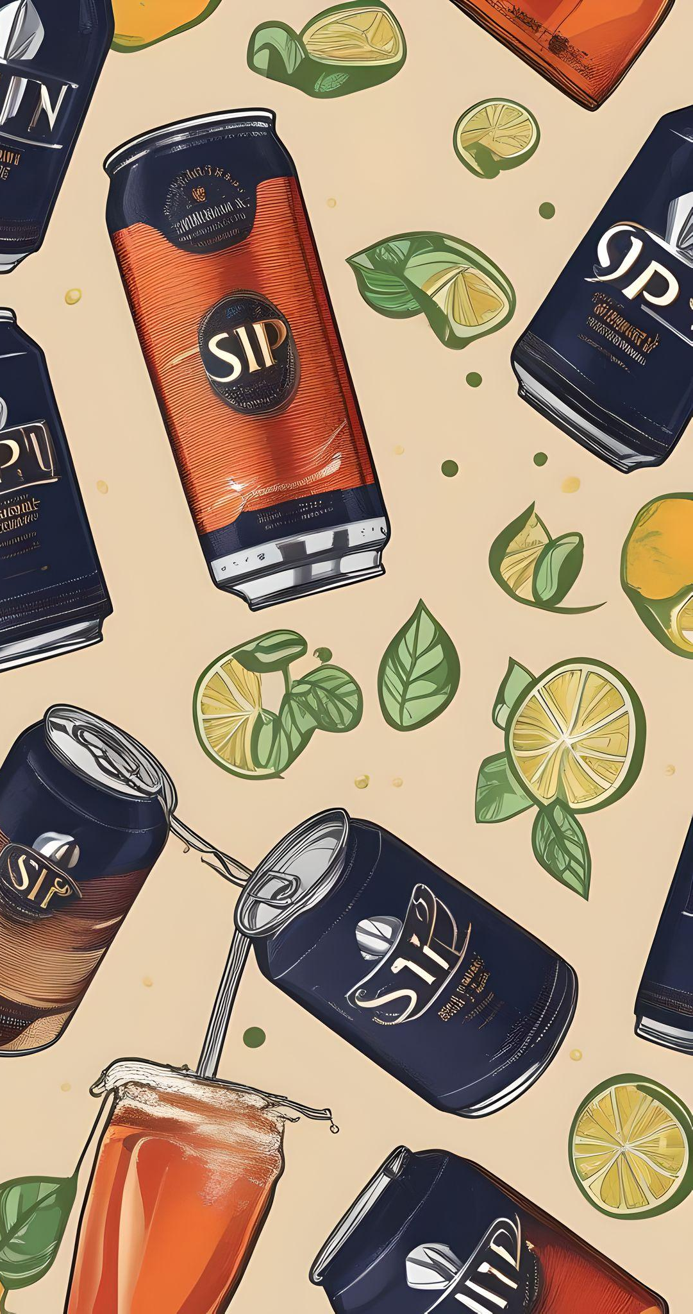
Embracing the Future
Growth Beyond Measure
Community Involvement
We envision a future where our brand becomes synonymous with the finest beverages, spreading joy and becoming an emblem of quality and excellence.
As we forge ahead, community engagement and social responsibility will remain at the core of our initiatives, empowering and uplifting our surroundings.
Join the Journey
Be a part of our story and indulge in the delightful world of our canned cocktails. Join us in creating memorable moments, sparking conversations, and redefining the Indian drinkscape.

Slide 8
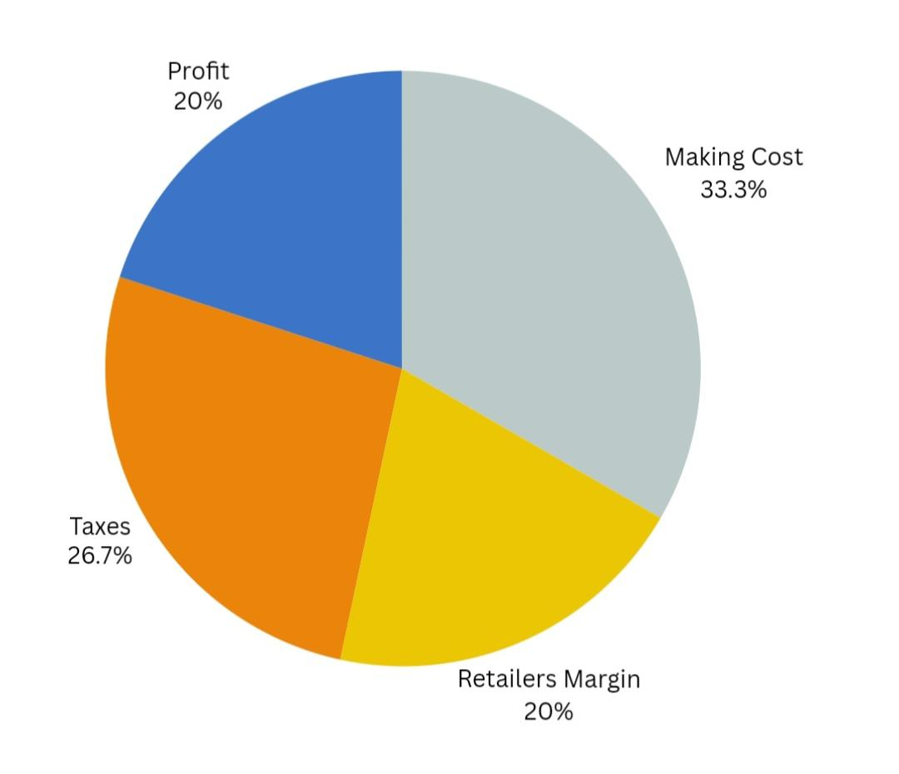

RIN-N-TONIC JISKEY WHISKEY NO GUM RUM ESPRESSO MARTINI RIN-N-TONIC JISKEY WHISKEY NO GUM RUM ESPRESSO MARTINI RIN-N-TONIC JISKEY NO GU
Sip-n-Can was valued at 10cr in 2020
Valuation & Stats
Annual sales – 20k crates
AOV – 600 INR
MRP – 150 INR per can
Manufacturing – 55 INR
RIN-N-TONIC JISKEY WHISKEY NO GUM RUM ESPRESSO MARTINI RIN-N-TONIC JISKEY WHISKEY NO GUM RUM ESPRESSO MARTINI RIN-N-TONIC JISKEY NO GU

Slide 9


